Slide 1
The Emergence of Organized Capitalism in the Core
1890-1960s

Slide 2
Introduction
When many workers belonged to labor unions, when business saw value in negotiating with labor with government as a mediator, and income taxes were introduced and relatively progressive income taxes (the more the income the higher the rate) to pay for public goods that underpinned the growing cities and suburbs of the periods (highways, subways, public schools, etc.)
1. What was “organized capitalism”? 2. How did it happen? 3. Where did it happen? 4. What was the economic logic behind it?

Slide 3
1. What was organized capitalism?
Organized capitalism emerges from the 1890s and lasts until the 1960s. Its origins are in the monopoly capitalism (vertical integration and firm economies of scale) of the third wave of the industrial revolution in Europe and its counterparts in the US and Japan noted in the last lecture.
Twin roots: overcoming profit squeeze through increasing levels of consumption (this required raising wage rates not reducing them) and increased government regulation. The 1870s-1890s was a time of the Long Depression across the industrial world (particularly the US). It was reversed with investments in electricity and the internal combustion engine (for vehicles) (see Figure 1).

Slide 4
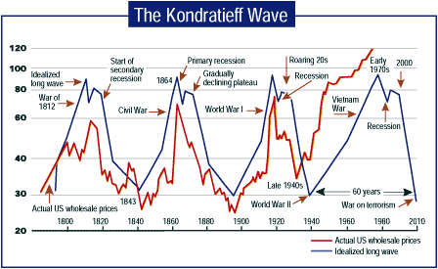
Figure 1: Note Deep Downturn in Prices of Commodities 1870-1900 followed by recovery until 1920s

Slide 5
2: How did it happen? I. GOVERNMENTS AS MEDIATORS BETWEEN BIG FIRMS AND LABOR
Increased regulation of business and finance (e.g. Federal Reserve in US, FDA in USA)
Government pension schemes
Anti-monopoly legislation (e.g. Sherman Antitrust Act of 1890)
Pushed by “progressive” and socialist politicians and by workers pushing for higher wages. Some businesses recognized that they increase sales and profits if they paid workers more (e.g. Ford)

Slide 6
II. NEW “SCIENTIFIC” ORGANIZATION OF PRODUCTION
The other side of the “deal” was to increase worker productivity:
Assembly-line production (introduced by Ford in the US in 1907)
Based on “Taylorism:” (after Frederick Taylor) time-and-motion studies, efficient use of labor within factories (specialized by task). Producing the Model T Ford was reduced to 84 discrete tasks (Figure 2).

Slide 7
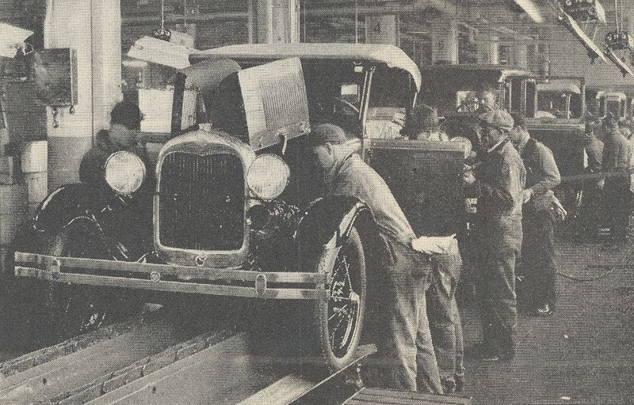
Figure 2

Slide 8
III. HIGHER WAGES/HIGHER CONSUMPTION (FORDISM)
With increased production needed increased sales (Figure 3)
Simple logic: pay workers more, sell more, profit more as opposed to pay workers as little as possible, sell to the lower proportion of the population with disposable income at higher prices, profit.
Cheaper products for mass consumption (like the Model T), advertising, consumer-credit economy

Slide 9
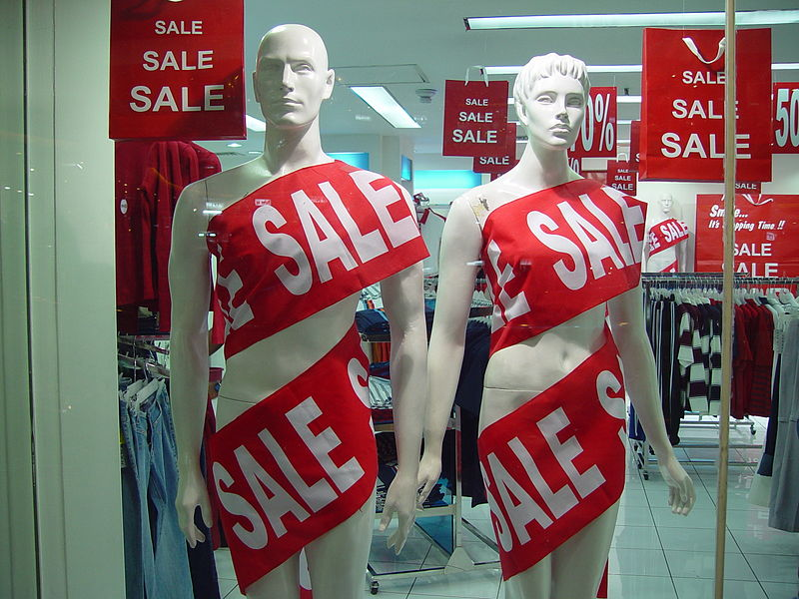
Figure 3: You can never buy enough

Slide 10
IV: RISE OF THE WELFARE STATE (begins in 1900s but intensifies following the Great Depression of the 1930s)
Provision of healthcare benefits by either governments or businesses
State pensions
Unemployment benefits (presumed counter-cyclical)
Retraining of workers
Mass public education
Always more reluctance to expand the welfare state in the US.

Slide 11
V: INTERGOVERNMENTAL MANAGEMENT OF INTERNATIONAL TRADE AND CURRENCIES
Gold Standard (1870s-1930s) Britain as linchpin
Bretton Woods Agreement (1944-1971) US as linchpin

Slide 12
3: Where? STARTED IN USA BUT FULL MODEL NEVER ADOPTED THERE
Federalism: some states hostile to unions (mainly in the South)
Liberal ideology and private versus public goods (e.g. healthcare)
Less government mediation between capital and labor relative to Europe or Japan.

Slide 13
4. THE BASIC BUSINESS MODEL
1. Integrated firms operating nationally (limited out-sourcing to other firms and limited internationalization of firms)
2. Vertical integration
3. Single-site economies of scale
4. Single-strand supply chains
5. National markets dominate
6. High levels of labor unionization (national wage bargaining)
7. Governments as “brokers” between business and labor

Slide 14
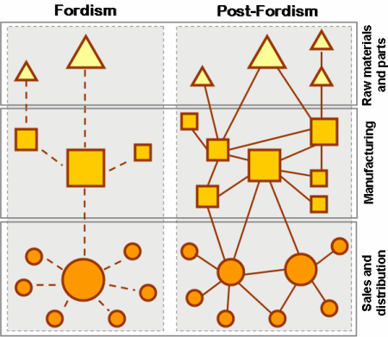
Figure 4: Vertical Integration (left) characteristic of Organized Capitalism (Fordism)

Slide 15
WHAT WAS THE LOGIC BEHIND THE SHIFT TO ORGANIZED CAPITALISM (FORDISM)?
Defuse class hostility (Populist and socialist movements in the 1890s, early 1900s)
Stimulate profits/economic growth
Try to flatten business cycle
Combine economies of scale in big companies with government regulation/mediation as an alternative to more competition
Encourage consumption as engine of economic growth

